Slide 1
Transition To College: Developing Individualized Transition Plans That Address Academic, Social, And Emotional Readiness
Jessie Green, PhD
Karen Krainz Edison, MSW, LISW-S

Slide 2
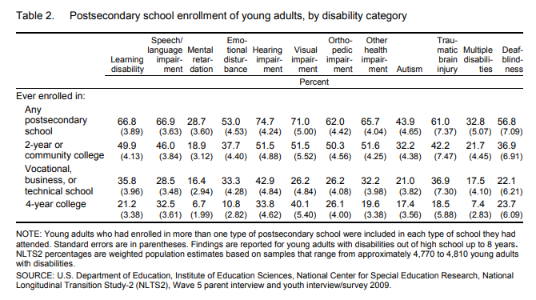
NLTS-2
Notes:
How do you prepare students for navigating the academic, social, and emotional journeys as they transition out of high school? Jessie Green & Karen Krainz Edison from The Nisonger Center at The Ohio State University will discuss how families can craft Individualized Transition Plans during Morning Session 1b.

Slide 3
OLTS
Notes:
https://www-s3-live.kent.edu/s3fs-root/s3fs-public/file/2022%20OLTS%20Annual%20State%20Report_0.pdf?VersionId=HfN1s3tL04m8UftIsGFUuXG_uN6AVNp7

Slide 4
Executive function
Just because they are smart doesn’t mean they have the EF skills to match
Lack of focus, getting distracted
Emotional regulation
Impulsiveness/recklessness
Deciding on or prioritizing a goal
Knowing how to establish a routine
Evaluate progress or self-reflect
How to act on the evaluation or reflection
Estimating time for a task
Apply different rules to different situations
https://lifeskillsadvocate.com/executive-functioning-101-hub/
Notes:
Above the surface- what you can see
Below- what you cant. This can be misunderstood as behavioral issues vs executive dysfunction
Deciding on or prioritizing a goal- are they stuck and thus cannot start a task or project?

Slide 5
Moving to post-secondary education
Multiple areas of transition
Shift from directed to independent learning
Change, Change and more CHANGE
In academics and in daily routines
Many new areas of responsibility
Find natural supports & expand support system
Planning should be considered early
Financial responsibility is on the student/family
Includes tuition, housing, food, medical, transportation, tutoring, or other supports

Slide 6
Facing the unknowns
Students face challenges
•Developing college-life boundaries
•Managing time and priorities
•Recognizing the culture or “unspoken rules” of a college class or campus
•Socializing or avoidance of social settings
•Communication and self-advocacy with peers and professors
•Working as a member of a team
•Understanding peer and college faculty/staff perspectives

Slide 7
Changes in the classroom
Understanding course expectations
Communicating learning differences to professors and instructors
Managing course loads
Understanding change in responsibility for learning

Slide 8
Changes in day-to-day activities
Managing time and priorities- academics, socializing, self care
Living independently, working with roommates
Learning how to get around campus
Interacting socially with peers and staff
Lack of family or peer support to navigate campus systems
Limited self-advocacy skills

Slide 9
Twice gifted, appropriately supported?
Are teachers prepared to educate students with diverse learning styles
Approach from a deficit versus strengths-based perspective
Areas of development varies widely
Language may not be as advanced as deductive reasoning
Can do complex mathematic equations in their head but can not explain the steps
Are multiple ways to receive and digest course content provided
Are diagnoses missed or incorrect
Is the student curious or disruptive
Are learning disabilities evaluated by trained staff or professionals

Slide 10
Twice gifted, appropriately prepared?
Accommodations not formally applied
Natural supports were abundant
Student’s lack of awareness of their learning differences
Were students equipped with
Adequate reading and notetaking strategies
Adequate test preparation and test taking strategies
Student expectation that college coursework will be
The same teaching style as high school
Materials will be provided by the professors
Personalized classroom experiences
Easy -now that they select their major or area of interest
Unprepared for application and generalization of course content

Slide 11
Autism Support Programs
Independent and campus programming that provides individualized support to degree-seeking autistic and neurodivergent students
“ASPs are designed to support autistic students’ success by capitalizing on strengths and providing them with support that meets their distinctive needs.
Researchers found ASPs can offer up to ten types of supports, services, and accommodations (Cox et al., 2020)”
Services offered outside campus Accessibility/Office of Disability Services
Curriculum Planning
Tutoring or Academic Coaching
Specialized Orientation or Transition Services
Communication or Self Advocacy Skills Training
Life Skills Training/Support
Mental Health Support/Therapy
Peer Mentors
A network of support for higher education autism professionals and student self-advocates is provided by the non-profit College Autism Network

Slide 12
Components of ASP services (Ace! At OSU)
Individualized Planning and Assessment
Support with Registration, Disability Services, and Residence Services
Advocacy support during urgent or more serious situations
Staff to serve as a liaison with faculty, administration and student organizations.
Academic Support
Strategies designed to teach effective organizational skills, monitoring for oversight
Assistance with identifying reasonable accommodations, and supporting the student in obtaining needed accommodations
Assistance with learning effective study skills
Communication & Self Advocacy Supports
Assistance and support for learning and using effective adaptive living skills
Assistance navigating through the day-to-day needs of campus life
Assistance and encouragement for active involvement in community (both on campus and off campus), and development of support strategies to assist the student with independence

Slide 13
Ohio’s Autism Support Programs
Ace! at The Ohio State University
ACES at University of Dayton
ASD Affinity at Defiance College
ASPeCT at Ohio University
PLUS at Muskingum University
RASE at Wright State University
X-Path at Xavier University

Slide 14
IPSEs (national and Ohio context- Jessie)

Slide 15
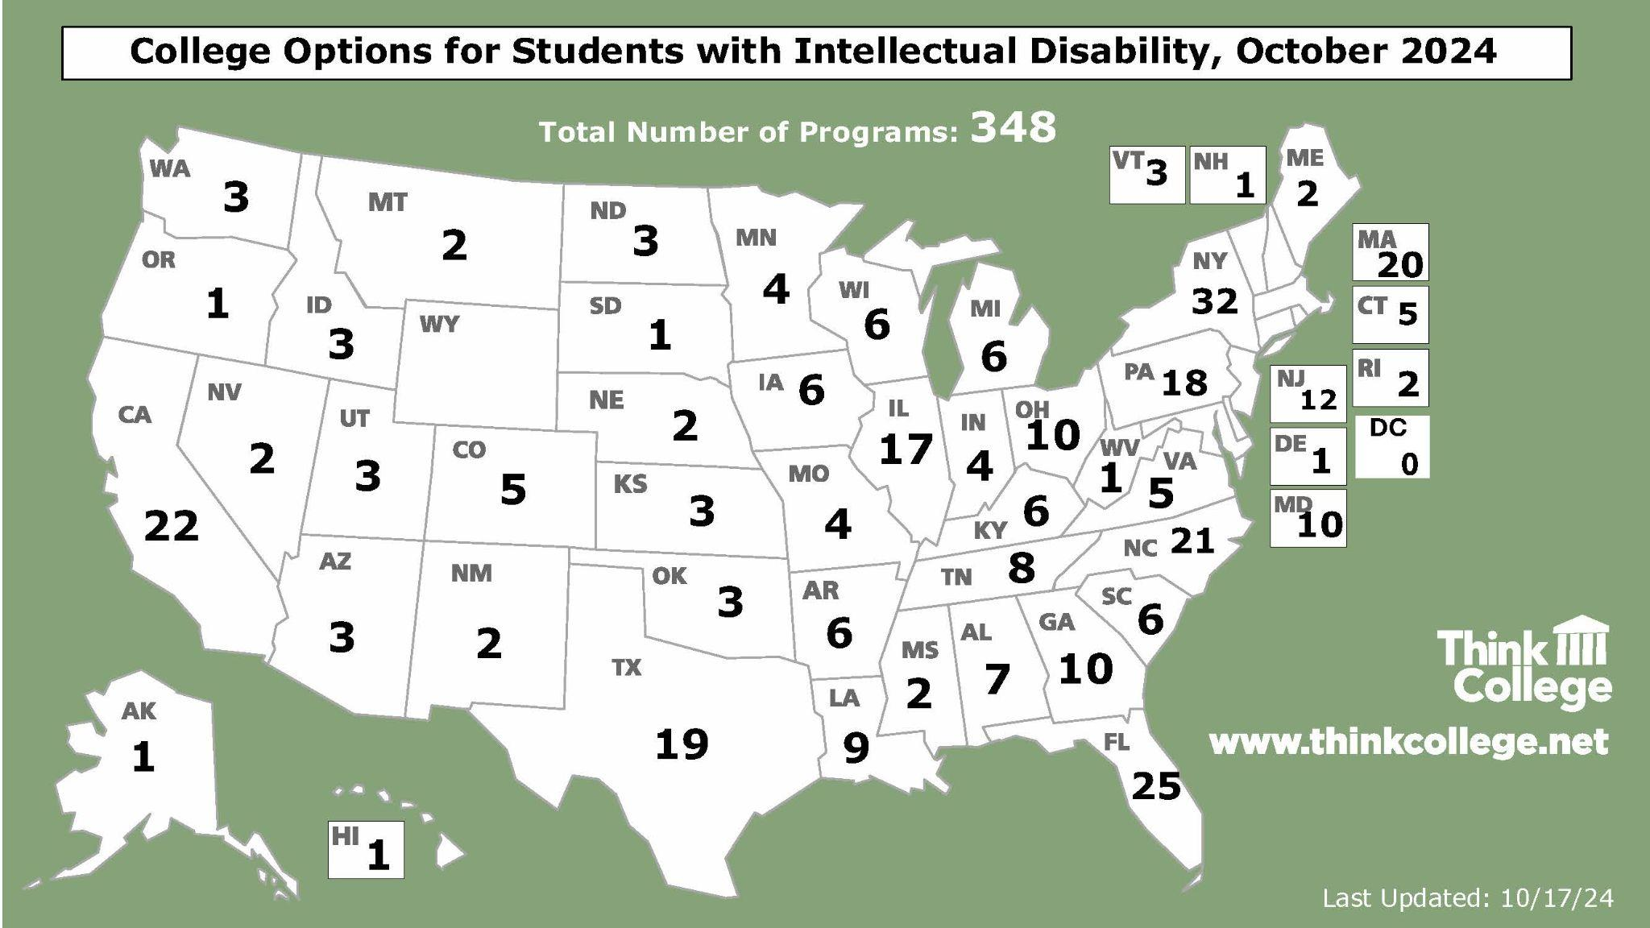

Slide 17
Some key features of college programs for students with intellectual disability
Different admissions process & requirements
Accept students who are non-degree seeking
Vary in length from 1 to 4 years
Vary in level of inclusion
Students earn a certificate at the end
May offer federal student aid (not loans)
Notes:
You see the word vary on this slide a fair bit – programs differ in important ways. What they all have in common is that they offer an alternative admission process that admits students into their program to earn a certificate of some kind – these programs do not themselves award degrees However, some students have gone on to earn degrees and the programs have offered support to them to do that.
This is a basic overview of programs – does anyone have any questions about any of these features? I am happy to give more detail.

Slide 18
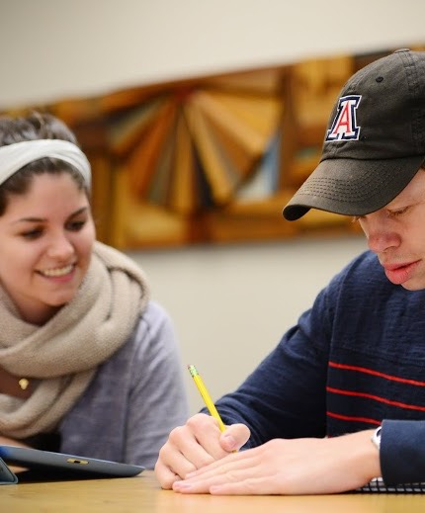
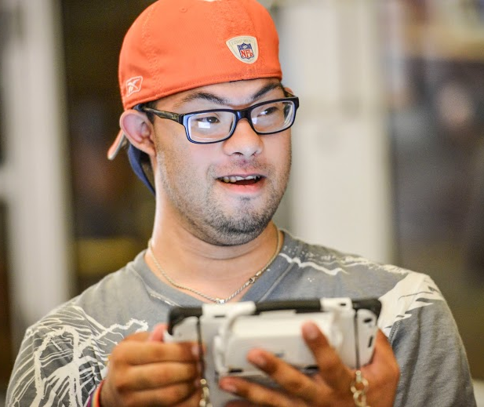
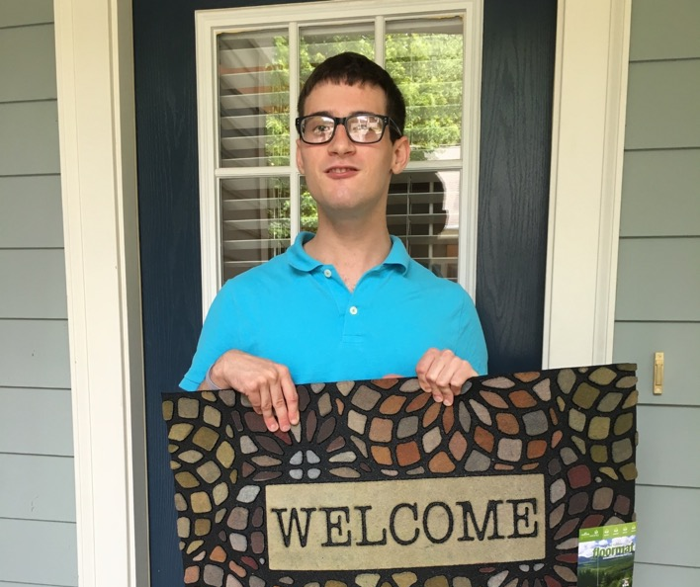
Student experience
Enrolling in college courses for credit or audit
Internships/work study
Paid jobs (on/off campus)
Campus Life/Organizations
Learning to live in(ter)dependently
Notes:
Again, while things can vary from program to program, these bullets represent the common experiences that students with have in these programs.
Go through each bullet and give examples
Let’s pay attention to a little addition I did on this slide – the parens in the last bullet. College is a place that all young people learn to live without as much of mom and dad’s support – but not NO support, right? What they learn is where they can do things on their own that maybe they did not think they could – like take a bus across campus and find their classrooms, take care of their own dorm room, be an active member of a campus club – and they also learn what kinds of supports they need to live the live they want – and by gaining confidence and finding their voice – learn how to ask for that support, and how to give help to their friends, how to live interdependently.

Slide 19
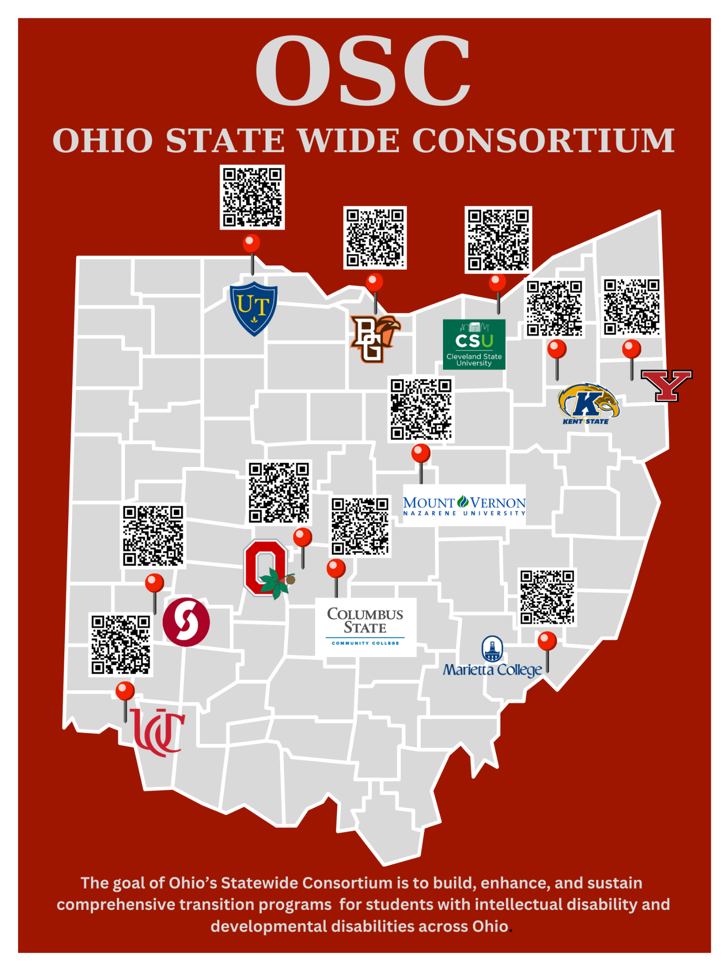
Ohio Statewide Consortium
Bowling Green State University - Firelands
Cleveland State University
Columbus State University
Kent State University
Mount Vernon Nazarene University
Ohio State University
Sinclair Community College
University of Cincinnati
Sinclair Community College

Slide 20
Parent mentor discussion
How are you helping families find this info?
When are you having these conversations with families?
What resources do you need to be supported in having these conversations?
Notes:
Post its and paper pads

Slide 21
Academic transition activities
Incorporating and normalizing technology
Using electronic calendars to keep appointments or block scheduling
Include mealtimes, study times, etc.
Voice to text and text to voice apps
Use learning management systems
Sending and replying to email
Digital document storage solutions
Technology management for phone and computer
Student manages their own accounts (username and passwords)
Safe social media practices
Access to apps

Slide 22
Academic transition activities
Fade 1:1 supports (if applicable)
Expose students to public transportation when/if available
Student should handle money (paper or plastic)
Schedule own appointments
Job or volunteer opportunities
Engage with state agencies (e.g., VR, DD)
Student and family should attend all college information nights not just disability focused events
Students should be engaging with guidance counselors for support with scholarships and college applications

Slide 23
Social transition activities
Incorporating and normalizing technology
Using electronic calendars to keep appointments or block scheduling
Include mealtimes, study times, etc.
Voice to text and text to voice apps
Sending and replying to email
Technology management for phone and computer
Student manages their own accounts (username and passwords)
Safe social media practices
Access to apps

Slide 24
Social transition activities
Involvement in the home (e.g., cleaning, laundry, basic meal prep)
Involvement in extracurriculars
Provide students with alone time (overnight is a bonus)
Work as a part of a team

Slide 25
Emotional transition activities
Student shifts to leading medication management (e.g., refills)
Students need alone time
Discussions about college and adulthood
Clear planning for transition (or not) of mental health needs
Keen awareness of sensory needs

Slide 26
Scenario 1
Student is 14 (9th grade)
SLD diagnosis
Unsure of what they want to do after high school
Needs to improve flexibility, problem solving, social communication
Family is involved minimally

Slide 27
Scenario 2
Student with Down syndrome
16 years old (11th grade)
Parents are very involved
Wants to be Ohio State’s next head football coach
Parents support this goal
Wants to go to college
Student is the “mayor” of his high school

Slide 28
Resources
Family Resource Network of Ohio: https://frnohio.org/
Charting the LifeCourse: https://frnohio.org/lifecourse/
College-Ready
Workbook- College Readiness for Neurodivergent Students
https://www.college-ready.com/
Inclusive Academia Videos
https://www.youtube.com/@InclusiveAcademia
College Autism Network Student and Family Resources: https://canfamiilyresources.softr.app/
Smart Home Technology: https://nisonger.osu.edu/technology-project/shdp-2-2/

Slide 29
Resources
Think College Family Resources:
https://thinkcollege.net/family-resources
Think College- Conducting a College Search
http://programs.thinkcollege.net/
Think College- Differences Between H.S. and College
http://www.thinkcollege.net/topics/highschool-college-differences

Slide 30
Contact us!
TOPS: transitions@osumc.edu
Ace!: aceprogram@osumc.edu
Karen Krainz Edison: karen.krainzedison@osumc.edu
Jessie Green: jessie.green@osumc.edu

