Slide 1


Slide 2



MICAH MORGAN, LPC
EXPLORING
AS A PROTECTIVE FACTOR FOR CHILD ADVERSITY
CO-REGULATION

Slide 3
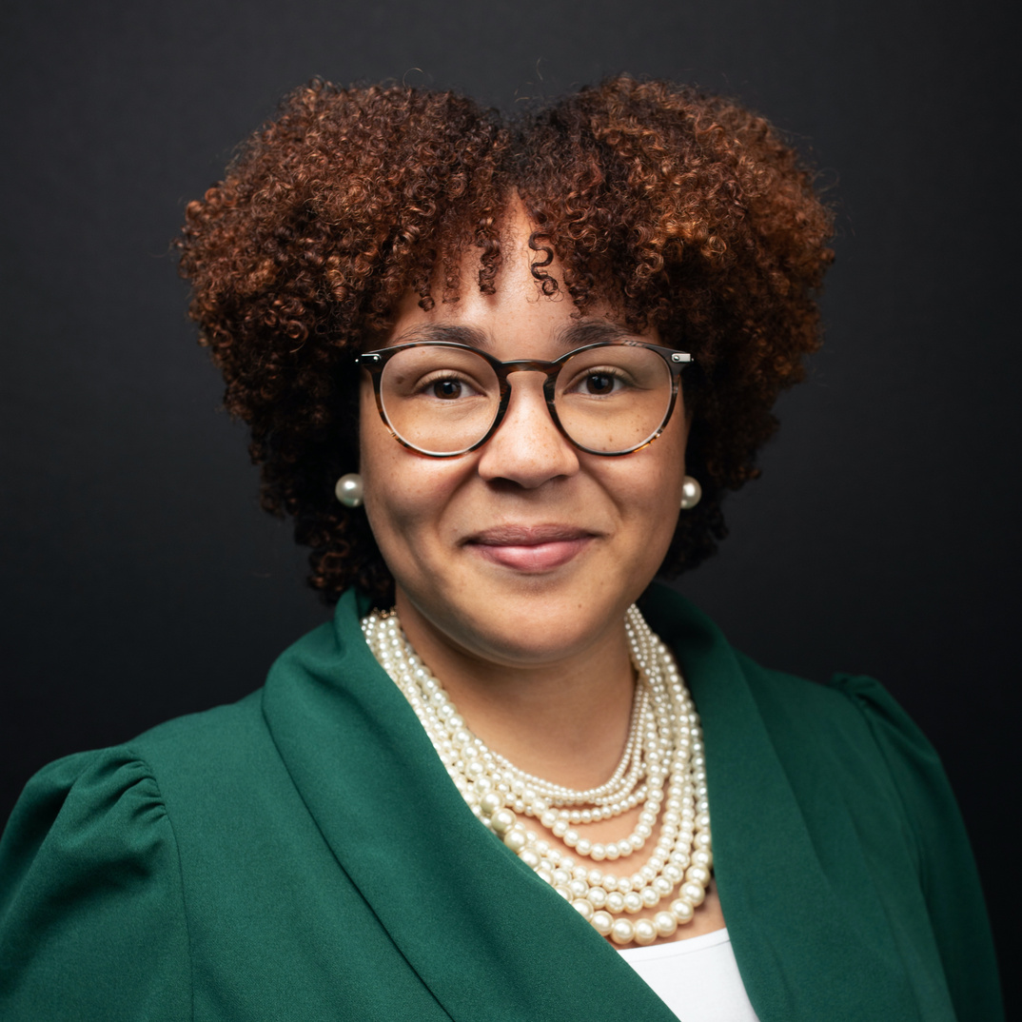
Pleasure to meet you!
Micah Morgan, LPC
  Licensed Professional Counselor
  Served in the mental health field since 2013
  Served in Community-based mental health for low income families
  Supporting children and families with a trauma history
  Supporting families navigating the special education process as a clinician and resource coordinator (FCFC)

Slide 4


Let’s discuss!
What do you already know about the terms “dysregulation,” “adversity,” and “trauma?”

Slide 5


Welcome To
This
Presentation!
Exploring Co-regulation as a Protective Factor for Child Adversity
In this session, participants will...
01
...review the cognitive, behavioral, and relational impacts of trauma
02
...reinforce at least three trauma-informed, co-regulation behaviors to implement with children and families as a protective factor against child adversity.

Slide 6

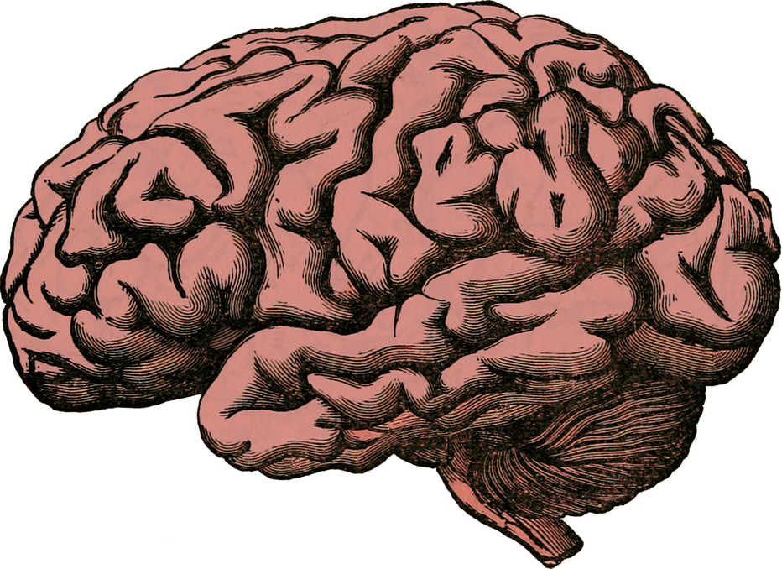





Concept:
THE “BOTTOM-UP” BRAIN
RATIONAL BRAIN - NEOCORTEX
SAFETY
LIMBIC SYSTEM - AMYGDALA
Development & processing
from the bottom up
REPTILIAN REGION - RETICULAR
ACTIVATING SYSTEM
The brain’s ultimate priority and function is to maintain physical and emotional safety.
All rights reserved © 2007-2019 Bruce D. Perry.

Slide 7

Concept:
THE “BOTTOM-UP” BRAIN & SYMBOLS OF SAFETY
I CAN DO MY BEST THINKING!
SAFETY
DO I BELONG?
Development & processing
from the bottom up
FAMILIAR? DO I CONTROL MY SPACE?
ARE MY SENSES AT EQUILIBRIUM?
When the lower parts of the brain "see" their symbols of safety,
the brain declares the body “safe” and regulated, and the Cortex can do its best thinking.
All rights reserved © 2007-2019 Bruce D. Perry.

Slide 8
Let’s discuss!
Every brain has come up with its own symbols of safety for the lower brain (and many of our brains share these symbols in common). How would you describe your symbols of safety for the lower brain? What symbols of safety have you observed in your child?
DO I BELONG?
IS IT FAMILIAR? DO I CONTROL MY SPACE?

Slide 9
Concept:
DYSREGULATION, ADVERSITY & TRAUMA
I DON’T BELONG!
THIS IS NOT FAMILIAR! I DON’T CONTROL MY SPACE! MY SENSES ARE NOT AT EQUILIBRIUM!
Dysregulation
Temporary experience where the answers to these questions are “no.”
Adversity
Prolonged experience where the answers to these questions are “no.”
Trauma
Prolonged and/or overwhelming experience where the answers to these questions are “no.” Leaves lasting impact on functioning.

Slide 10
Concept:
DYSREGULATION, ADVERSITY & TRAUMA
for children with disabilities
I DON’T BELONG!
THIS IS NOT FAMILIAR! I DON’T CONTROL MY SPACE! MY SENSES ARE NOT AT EQUILIBRIUM!
Dysregulation
When disabled people access supportive services, they likely encounter attitudes and actions that negatively impact the quality of services (K. McBride-Henry, 2023).
Adversity
18.6% of children with a disability had experienced two or more stressful events compared with 6.5% of children without a disability (CDC, 2019).
Trauma
Children with disabilities are more than twice as likely to experience abuse and violence as children without disabilities (CDC, 2020).
Notes:
Sources:
For Children With a Disability, a Higher Risk of Trauma (Steven Ross Johnson, 2022)
Disabled people’s experiences accessing healthcare services during the COVID-19 pandemic: a scoping review (Karen McBride-Henry, 2023)

Slide 11
Concept:
DYSREGULATION, ADVERSITY & TRAUMA:
how it shows up
I DON’T BELONG!
THIS IS NOT FAMILIAR! I DON’T CONTROL MY SPACE! MY SENSES ARE NOT AT EQUILIBRIUM!
Dysregulation
Adversity
Trauma
  Increase in stress hormones
  Difficulty making and retrieving new memories
  Difficulty focusing
  Difficulty managing emotional responses
  (Trauma) Mistrust of others
  (Trauma) Lowered self-worth
  (Trauma) Negative view of the future

Slide 12
Concept:
DYSREGULATION, ADVERSITY & TRAUMA
for children with disabilities
Whenever we come alongside a family navigating the special education process, we also come alongside their dysregulation, adversity, and/or trauma.
Dysregulation, adversity, and/or trauma impede a family’s ability to do their best thinking as they navigate systems.

Slide 13
Let’s discuss!
When you think of what’s involved in navigating the special education process (either for yourself or the families you support), what elements of that process cause distress or discomfort for a family?

Slide 14


Concept:
CO-REGULATION AS A SOLUTION FOR DYSREGULATION, ADVERSITY & TRAUMA
Synchrony,
Neuroception of safety
RIGHT
BRAIN
RIGHT
BRAIN
When we hold the work of Allan Schore, Stephen Porges, and Frans DeWaal in conversation with one another, we discover that Co-regulation can be one of the most effective ways to resolve dysregulation, adversity, & trauma. Co-regulation is the process of emotionally regulating with another person by influencing one another’s behavior either subconsciously or overtly through messages of perceived safety (Fogel, 1993).
Notes:
As integrative creatures, humans synchronize with those around them. DeWaal (2009) argues that synchronicity builds upon the ability to map one’s own body onto that of another, making others’ movements their own and leading to shared, matched activities. This is why we find ourselves yawning when someone else yawns, laughing when someone else laughs, and crying when someone else cries. In essence, this is empathetic behavior. This is why, for example, when watching someone else take part in a risky activity, humans experience an adrenaline rush and the accompanying thrill without actually taking the risk themselves (DeWaal, 2009). (Dr. Benjamin Kearney, pg. 9)

Slide 15




Co-regulation:
What to offer your family
Co-regulation is the process of emotionally regulating with another person by influencing one another’s behavior either subconsciously or overtly through messages of perceived safety (Alan Fogel, 1993, adapted).
Peace
Power
Predictability
Influencing the family’s sense of calm by increasing their symbols of safety in the lower brain.
Facilitating the family’s ability to use their own agency.
Reducing the
family’s experience of novelty.

Slide 16

Let’s discuss!
In what ways are you already offering your families peace, power, and predictability during the supportive process?
Peace
Power
Predictability

Slide 17
Co-regulation:
What to offer your family
Co-regulation is the process of emotionally regulating with another person by influencing one another’s behavior either subconsciously or overtly through messages of perceived safety (Alan Fogel, 1993, adapted).
Peace
  Show up regulated to every interaction (i.e., synchrony)
  Break the ice of every interaction with “connection” time (e.g., humor, empathy)
  Accommodate for signs of dysregulation
  Adjust tone to convey empathy
  “Repair when there’s a tear” (e.g., addressing lapses in knowledge or missed expectations)

Slide 18
Co-regulation:
What to offer your family
Co-regulation is the process of emotionally regulating with another person by influencing one another’s behavior either subconsciously or overtly through messages of perceived safety (Alan Fogel, 1993, adapted).
Power
  Present multiple choices where possible
  Equip families with written information to reference as desired
  Facilitate moments during meetings with school staff for caregivers to ask questions or verbalize thoughts
  Check-in for consent consistently (i.e., “would you like to take a different direction”)

Slide 19
Co-regulation:
What to offer your family
Co-regulation is the process of emotionally regulating with another person by influencing one another’s behavior either subconsciously or overtly through messages of perceived safety (Alan Fogel, 1993, adapted).
Predictability
  Describe each step of the process ahead of time
  Explaining the “why” behind various process steps (equips family with transferrable knowledge)
  Provide ample time for transitions between system steps (how often can days or weeks’ notice be provided?)

Slide 20
Let’s discuss!
Based on today’s training material or conversation with other Parent Mentors, what do you plan to refine or try next in your work with families?

Slide 21



Thank you!
Micah Morgan, LPC
https://www.linkedin.com/in/micahjmmorgan/
@j.marie.morgan
micah.j.m.morgan@gmail.com

Slide 22


