Slide 1
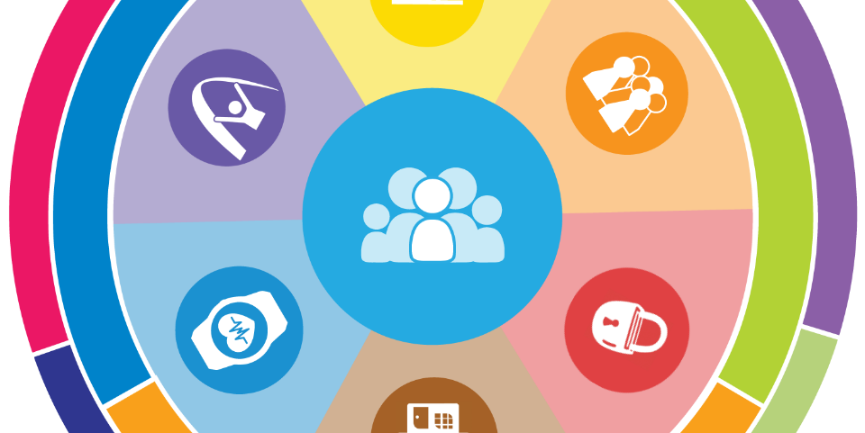
Charting the LifeCourse
Parent Mentor Conference
April 19, 2023
Notes:
Add the date and location to this slide

Slide 2
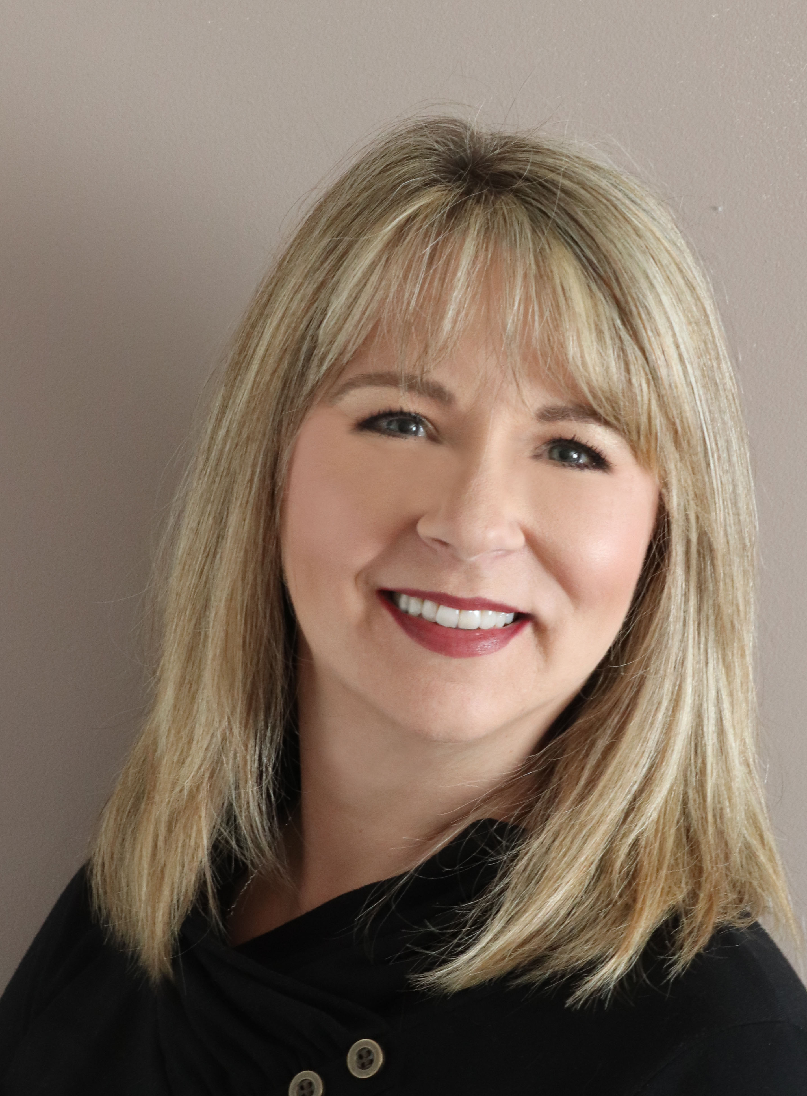
Today’s Presenter…
Tracey Manz is the Project Manager for the:
Family Resource Network of Ohio
Nisonger Aspirations program
Ohio Ambassador for Charting the LifeCourse.
As the parent of an adult on the autism spectrum, I have developed a passion for helping people with disabilities self-advocate, work toward independence, and assist in maximizing their full potential.
Tracey Manz
Tracey.Manz@osumc.edu
614-570-4113
Notes:
What is a CtLC Ambassador?
A certified Ambassador is a person who has:
Enhanced skill set to use CtLC in both personal and professional life, including problem-solving, life planning, formal planning, and strategic thinking
Confidence to use and share the principles of the CtLC framework
Commitment to ongoing learning, sharing, and contributing to person and family-centered practices
Charting the LifeCourse Ambassadors have:
Knowledge of the CtLC framework and methodology
Desire to learn how to implement CtLC at a more in-depth level in various settings

Slide 3
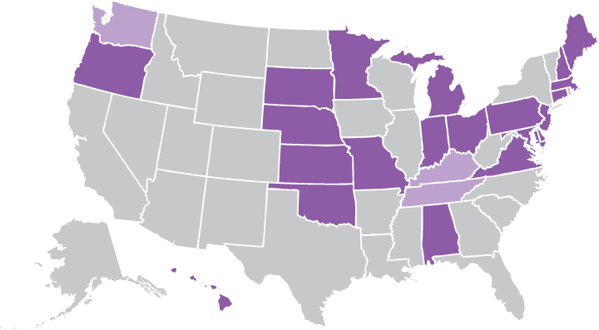
National Community of Practice for
Supporting Families
Project Outcome
State and national consensus on a national framework and agenda for improving support for families with members with I/DD.
Enhanced national and state policies, practices, and sustainable systems that result in improved supports to families.
Enhanced capacity of states to replicate and sustain exemplary practices to support families and systems.
Project Goal
To build capacity through a community of practice across and within States to create policies, practices and systems to better assist and support families that include a member with I/DD across
the lifespan.
Notes:
The Community of Practice was charged with developing a framework for supporting families.
Chose to model after the life course theory (from health)
Informed by Wingspread-Building a National Agenda for Supporting Families with a family member with Intellectual Developmental Disabilities
Framework started with Missouri Family to Family Mo F2F stakeholders. Plain language, not systems jargon.

Slide 4
Charting the LifeCourse…....
IS:
About having different conversations
A different way of thinking
Encouraging high expectations
Having life experiences to move the trajectory in the desired direction
Integrating LOTS of different kinds of support, and not just having an “all green life”
ISN’T:
JUST about the “tools”
A “program”
Is for ANYONE, regardless of AGE or ABILITY!
Notes:
Always emphasize especially that it is NOT about the tools but rather about the framework. The tools help with a visual or organizing structure. It’s about conversations and thinking differently.

Slide 5


WHY We Must Think Differently About Supports
75%
25%
ONLY 25% OF PEOPLE WITH IDD ACCESS FORMAL OR PAID SUPPORTS WITHIN THE DD SYSTEM
WHAT ABOUT THE OTHER 75%?
Notes:
Only about 25% of people and families who experience IDD receive IDD paid services. What about the rest? How do they have good lives? How do systems of support consider ALL people with IDD and families when making policies and improving practices?
We are SO focused on those inside the Service System – we forget they are the MINORITY. Majority may NEVER touch the Long Term Service System LTSS. Some don’t WANT to. Some won’t qualify. Some don’t know about the system.
While this graphic is specific to DD, other service systems are similar – ie – behavioral health, special healthcare needs, aging
3 out of 4 people with IDD are not getting and may never get paid DD services. It is important to help the 3 identify and access combinations of other kinds of support and help ALL 4 figure out different ways of getting supports.

Slide 6
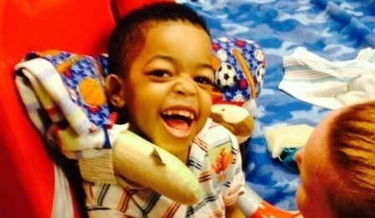
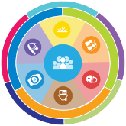
Guiding Principles of the
Charting the LifeCourse Framework

Slide 7
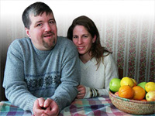
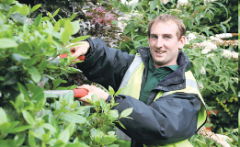
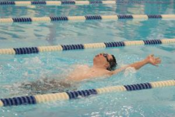
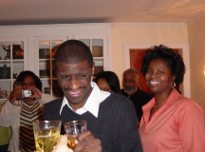
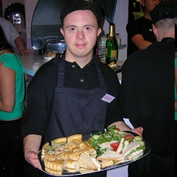
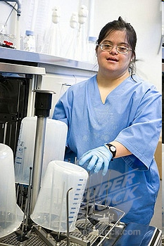
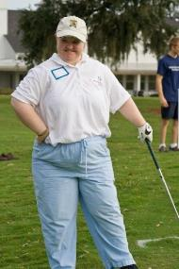
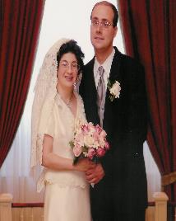
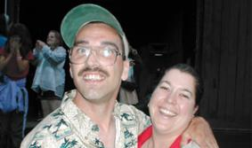
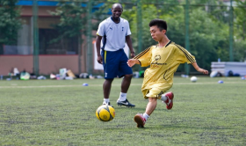
Core Belief:
All people and their families have the right to live, love, work, play
and pursue their life aspirations in their community.
Notes:
We don’t say ALL people “with disabilities” – but ALL PEOPLE. People With Disabilities are part of the ALL so we don’t need to single them out as different or special. NOT a separate framework for PWD.

Slide 8
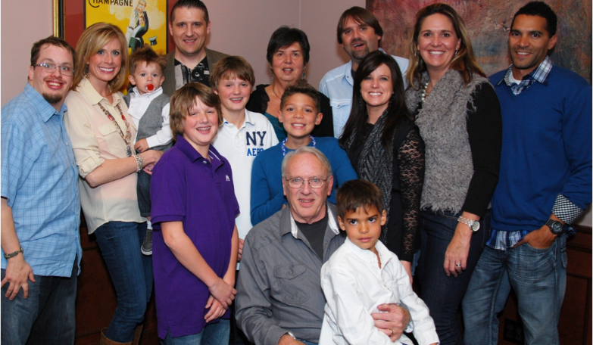
Person Within Context of Family & Community

Slide 9

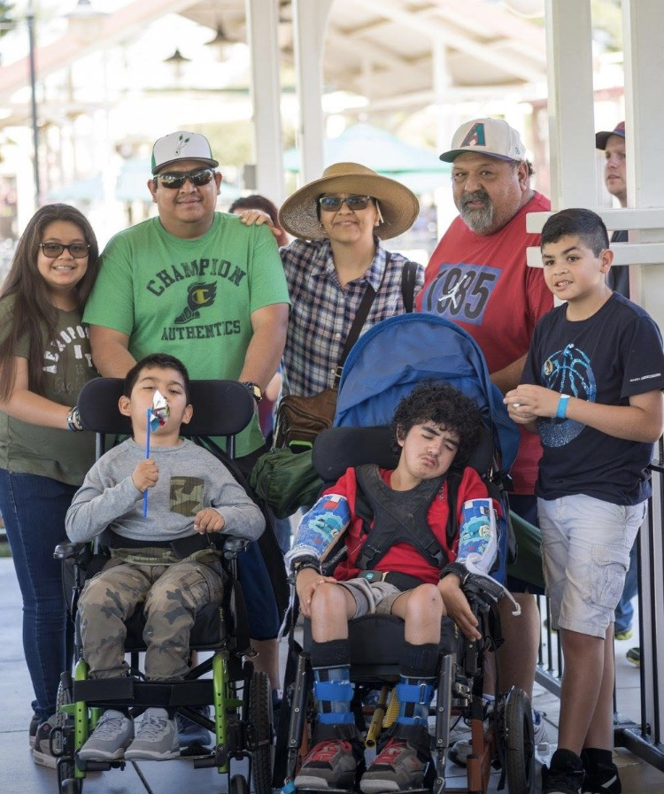
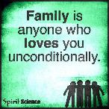
ALL individuals Exist within the Context of Family
Family is defined by the individual
Individuals and their family may need supports that adjust as roles and needs of all members change
Not dependent upon where the person lives
Notes:
No matter if person lives with their family (or not), talks to (or not) or if the family goes to meetings with the person (or not).
We have to be OPEN to their definition of family and whatever that means to them.

Slide 10
Where do People with I/DD Live?
89% living in own homes and/or are supported
by family
Anderson, L.L., Larson, S.A., Kardell, Y., Hallas-Muchow, L., Aiken, F., Hewitt, A., Agosta, J., Fay, M.L., & Sowers, M. (2015). Supporting Individuals with Intellectual or Developmental Disabilities and their Families: Status and Trends through 2013. Minneapolis: University of Minnesota, Research and Training Center on Community Living, Institute on Community Integration.
Notes:
How can we not talk about supporting families when a significant number of adults still live with family, or are receiving a great deal of support from family?

Slide 11
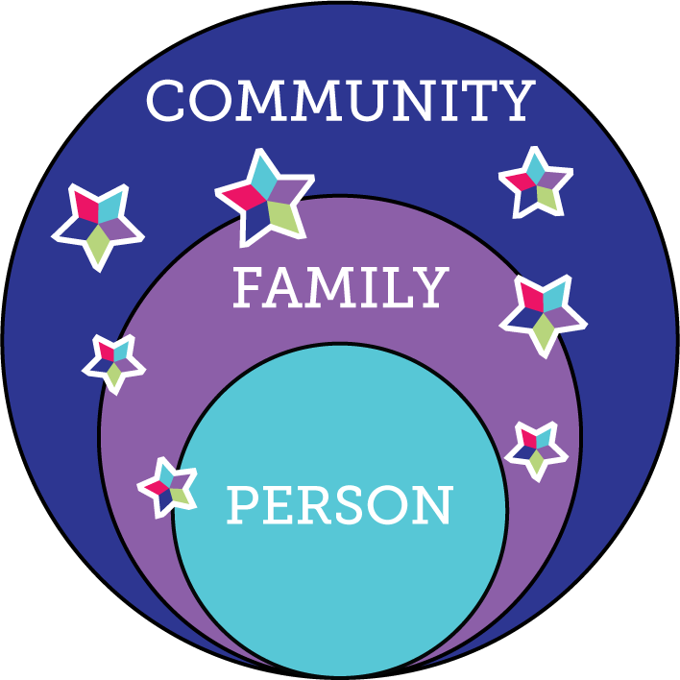
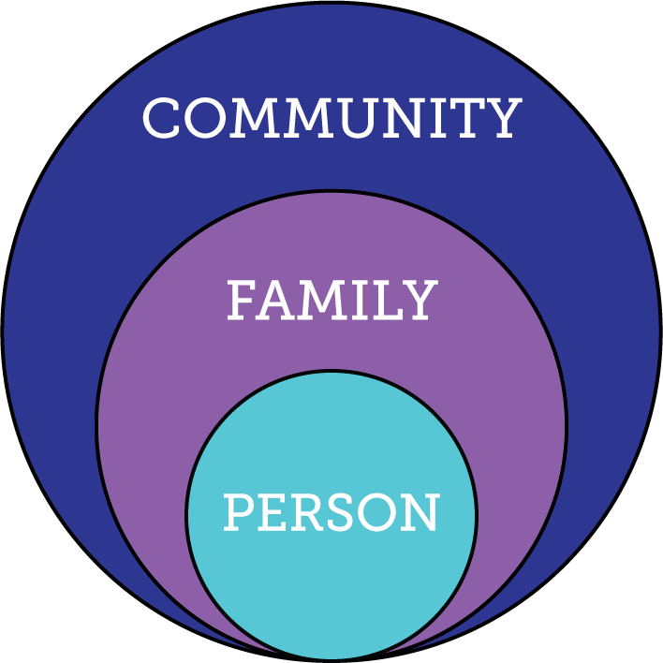
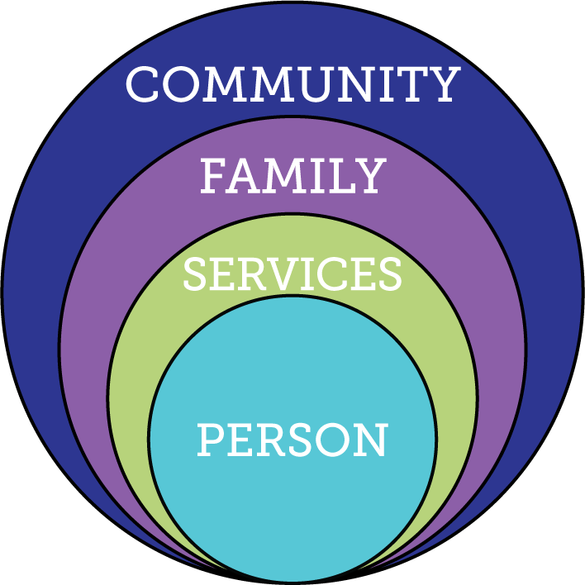
What We Want to See…
75%
People with I/DD not receiving formal DD services
25%
People with I/DD receiving formal DD services
100%
People with I/DD receiving integrated services and supports
Notes:
The circles on the left represent all of us – we all exist in the context of our families and communities. The middle circles represent traditional IDD services – sometimes, with the best of intentions, they wrap services so tightly around the person it cuts them off from their family, friends and community.
What we WANT to get to is the circles on the right, where the person receives lots of different kinds of supports, represented by the stars, but only where and when they are needed, and whether or not they are eligible for paid supports (the green part of the star)
More about the stars later

Slide 12



Reciprocal Roles of ALL Family Members
Caring About | Affection & Self-Esteem
 | Repository of knowledge
 | Lifetime commitment
Caring For | Provider of day-to-day care
 | Material/Financial
 | Facilitator of inclusion and membership
 | Advocate for support
*Adapted from Bigby & Fyffe (2012), Dally (1988), Turnbull et all (2011)
Notes:
#1 fear of all parents/families --- what will happen when I’m GONE? (but these are difficult conversations that parents don’t really want to have)
Having conversations with families (especially parents) about “Caring About” – who else can fill these roles when you are gone, and how can you start giving some of those things to others NOW while you are still around?
It doesn’t matter if you think you have all the “caring for” covered when you’re gone – what if it all falls apart? If there is no one that cares ABOUT the person to help figure it out, then it’s all for naught.
AND who does the person care ABOUT; who do they have a relationship with? Do they send cards or call on birthdays for loved ones? Is there someone they care about that they also care FOR? (ie- interdependent relationships especially with older families)
RECIPROCAL - reciprocity

Slide 13
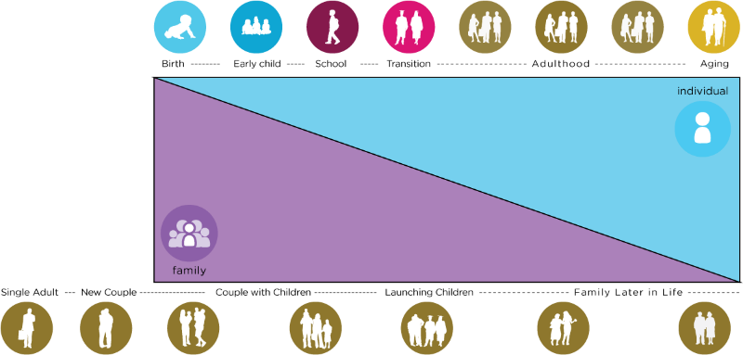
Family Life Cycle
Life Stages and
Individual and Family Cycles
Individual Life Stages
Notes:
We have to consider the individual’s stage of life, but also where/what stage other family members are in their lives. Are the parents aging? Are the siblings raising their own families? Is a sibling going away to college?
Stages – what happens in early or any stage, affects the stages to come. You have them for only a very short time in their lifespan, but what happens in those years can have profound effect on future (adult) years!
*45 Year old PWD – parent is 65 or older and might be caring for their own elderly 95 year old parent!
*12 year old with autism – also has a new baby in the house.
Consider the person you work with in the context of their whole family dynamic!

Slide 14

Lifelong Impact of
Family on Individual
Biologically: Likes, dislikes, skills, abilities
Socially: Family and friend network, connection with community members
Environmentally: Neighborhood, socio-economic, education
Policy:
Dreams, Aspirations,
House rules, cultural rules, expectations
Notes:
Biology – are we tall or short? Do we inherit tendency for certain illness? What do I want to do or be?
Socially – impact of reputation of the family – good or bad (like in school if you had an older brother/sister attend before you); connected socially/social networks (what are those connections and reputations??)
Environmentally – the neighborhood we grow up in; our family’s education level, financial status; (ie - Farm vs City)
Policy – house rules and expectations; important to understand expectations and norms. (everyone expected to go to college; make your bed every morning) Family CULTURE – so important – what you do on holiday, birthdays, traditions and things that are important in your family culture; how to hang stockings. WHO is going to know the family rituals???

Slide 15
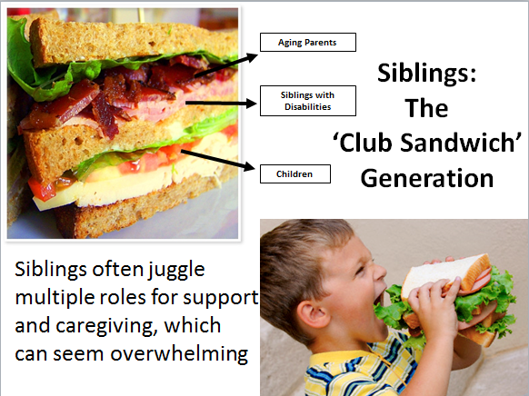
Notes:
We need to pay attention to siblings, particularly adult sibs. They are the lifelong companions. They are often in the “club sandwich” as they are starting or raising their own family, they may find themselves caring for or looking after their aging parents as well as their sibling with a disability. Do they KNOW the caring for and about details? Who or how are they being supported in their caring roles? Do they just want to be a loving sibling and not necessarily a caregiver?

Slide 16


“Good Life for All ”
The Individual will achieve self-determination, interdependence, productivity, integration, and inclusion in all facets of community life
Families will be supported in ways that maximize their capacity, strengths, and unique abilities to best nurture, love, and support all individual members to achieve their goals
Notes:
It’s important to consider the needs of BOTH the person and the family. Families are an integral part of the person’s life and support system – what do they need to be strong and have the capacity to help all the family members achieve their vision for a good life?

Slide 17
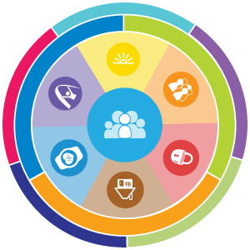

Supporting All Team Members
Supporting Person’s
Self-Determination
& Self-Advocacy
Supporting Families Across the Lifespan
Supporting Person-Centered Planning
Notes:
We’re all in this together! The framework and tools work for people with IDD, for supporting families, and to help supporters in their roles!

Slide 18
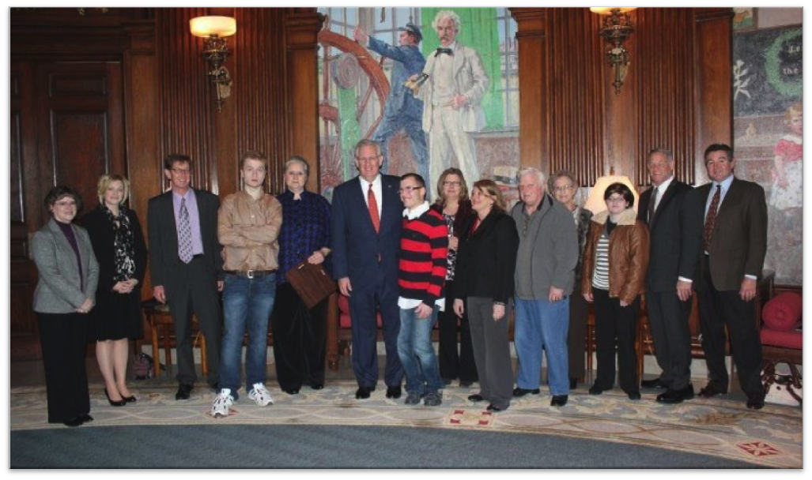
Policy, Systems & Community Change:
Person-/Family- Centered and Driven

Slide 19

Partnering with People with Disabilities and their Families
So they can Engage, Lead, and Drive
Policy and Systems Change
Notes:
How do we ensure people with disabilities and their families are involved in the process? How are they the voice of the change? Do they have a seat at the tables where things are decided? FCBDD Founded in 1951. just added a self-advocate to the board 2022 for the first time in its history. “Nothing about us without us!” Medicaid buy in cut offs. $935 maximum from SSI. Being on health insurance past 26 with a disability, Workplace discrimination, etc

Slide 20


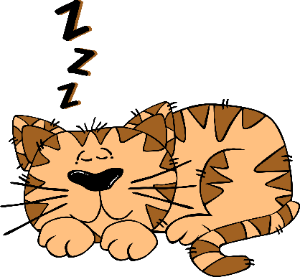
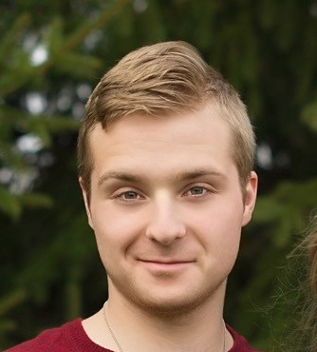



One Page Person Centered
Description
Introduces us to WHO the person is
At least 3 sections
What people like and admire about me
What is important TO ME
How to best support ME
Can be Word document with text boxes and graphics that the person wants
It can also include photo
I think it is very important!

Slide 21

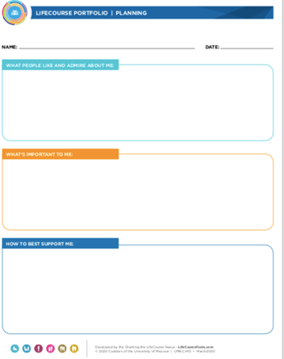
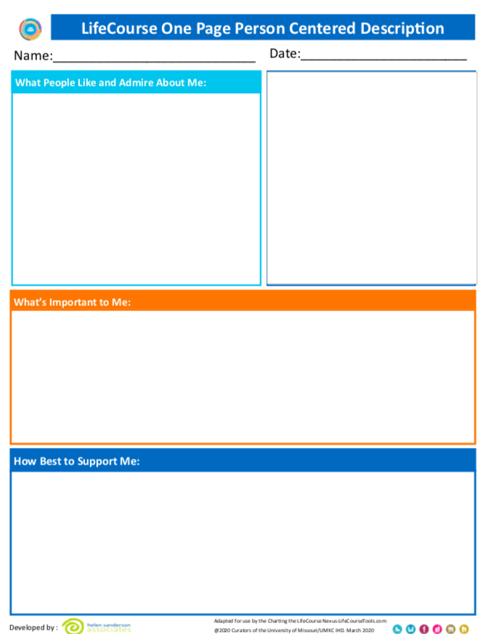
One Page Person Centered Description
What is a
“One Page”?
Shift the narrative, the way people with disabilities are talked about, from:
Disability based to person centered/human centric
Needs based to support based
You should always use a tool on yourself before you do it with someone else

Slide 22
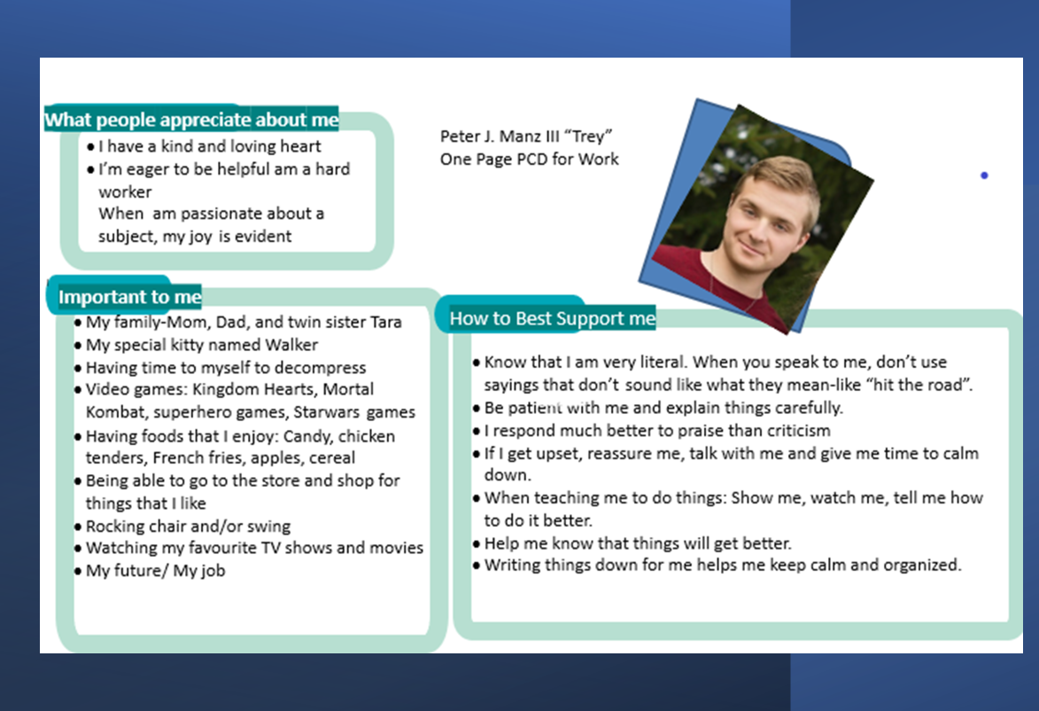
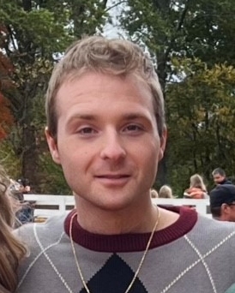


Slide 23
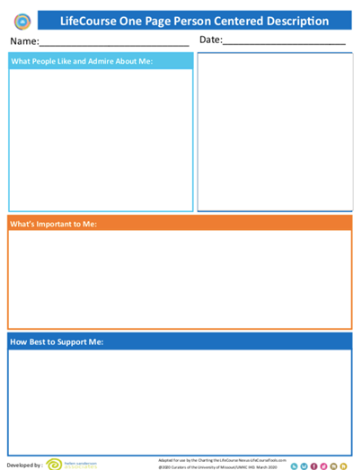
How did a Parent Mentor use this tool?
A teenaged son in a program Teen in gifted program preps for Student Centered Led Conference. Mom, a Parent Mentor, advises One Page Person Centered Description. Teen sees its versatility, jokes about organizing life. Develops profile, aids conference, fosters accountability. Teacher praises well-prepared presentation, applauds vulnerability. Freshman attending college classes, ample chances for self-advocacy.

Slide 24
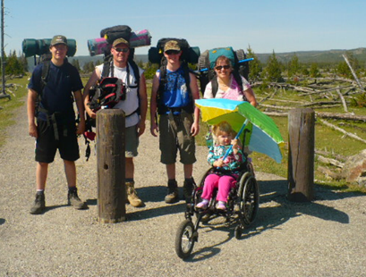
Life Trajectory, Experiences and Life Stages

Slide 25
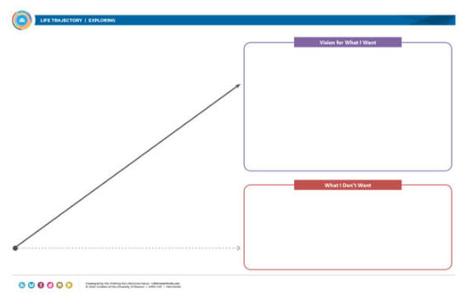
Trajectory: What do I want?

Slide 26
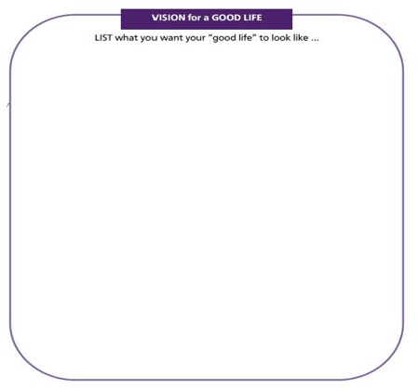
What is YOUR Vision
for a Good LIFE?
Vision of What I Want
Notes:
At their tables, or in small groups, using either a printed trajectory OR a blank sheet of paper where they can draw their own trajectory, ask the groups to think about and share with one another what their VISION for a GOOD LIFE is for THEMSELVES (not a family member with IDD, or someone they serve in their professional role, but for THEMSELVES, and write it in the upper circle. No judgements – people can say whatever they want their good life to be.
Circulate to make sure that someone in each group is writing down the group’s ideas.
Ask the group Who said: Family/friends; job they love, money, vacations, pets, chocolate, etc
How many people said: Good Behavior Plan????
IF there are only a few groups (and dependent on how much time you have), you can invite them to share out at each table.
EVERYBODY “gets” what “good life” means

Slide 27
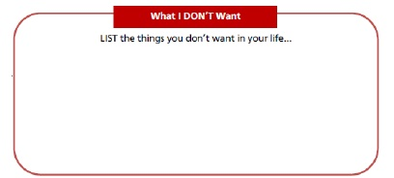
What DON’T you want??
Why is it important to talk about what we don’t want
Notes:
Repeat the process but this time ask the groups to focus on what they DON’T WANT for their own life
When you bring the groups back together, Ask = Who said: Poverty, isolation, segregation, loneliness?
Ask the group for anything else they included that hasn’t already been said.
IF there are only a few groups (and dependent on how much time you have), you can invite them to share out at each table.
Family sometimes can’t envision the good life – too many barriers, always a fight. But they can almost always tell you what they DON’T want!

Slide 28
Vision & Trajectory for a Good Life
Friends, family,
enough money,
job I like, home, faith, vacations, health, choice, freedom
Trajectory towards Life Outcomes
Vision of What I Don’t Want
Trajectory towards things unwanted
Notes:
What kinds of things do you want for YOUR good life? PWD and families usually want those same types of things. Everybody “gets” what the good life is. We just don’t usually ask them! What kinds of things do you think PWD and families will say they DON’T want? Sometimes you need to start there – they may not know what they want (because they are thinking in disability world) but they almost always can tell you want they don’t. FAMILY should have a good life trajectory too.
TRAJECTORY is the path that will either lead you toward the good life or toward things you don’t want. Think about throwing a football – the path that the ball takes on it’s way to the receiver is the trajectory. If you shoot an arrow, or a nerf gun – the path that the arrow follows is the trajectory. YOU CAN START at ANY AGE!!!!
Support coordinators, providers, Direct Support Professionals, Vocational Rehabilitation counselors, teachers….. ALL have the power to impact someone’s trajectory, sometimes it’s a positive impact, but also sometimes negatively, with their actions or words. We must be very careful and mindful of the impact we can have. Are we nudging the person and family toward what they want or what they don’t want?? EACH interaction, think about which way it nudged their trajectory!
Insert a story here if you have one
For example – It is so easy to do the wrong thing. No responsibilities, video games, youtube
Trajectory isn’t always straight
We all have bumps in the road (lose a job, get a divorce, illness, etc. – you can get back on track
VISION and TRAJECTORY can be very broad or very specific and time limited. Might be what are we doing/what’s happening this week, or around a specific topic or life issue (lose weight, buy a house, etc)

Slide 29
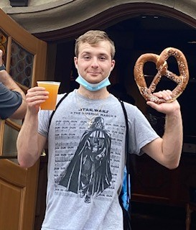
Trey’s Good Life Vision
Family, Friends, Vacations. Wife and Kids, Video Games, Concerts, Money, Job, Good Food, Cider Beer, Cat, Going to the Store, Work at Disney, Staying safe & healthy
Poverty/No Money, Poor Health, Mom unhappy with him, Isolated or Segregated, Treated Differently, Taken advantage of
Notes:
TREY’s goals and preferences
Must recognize what is important to who the trajectory is discussing.
Trajectory isn’t always straight
Bumps in the road – you can get back on track
VISION and TRAJECTORY can be very broad or very specific and time limited.
Trajectory isn’t always straight
Bumps in the road – you can get back on track
VISION and TRAJECTORY can be very broad or very specific and time limited.
TELL THE PILOT STORY

Slide 30
How did a Parent Mentor use this tool?
A Parent Mentor was approached by a 16 year old student who was sent to a special segregated school after he made some poor decisions leading to dangerous actions. He approached her and said he wanted to return to his local High School. She used the Trajectory to frame her conversation with him and to learn what he really wanted and how sincere he was. She asked him what he did not want-his quick reply, “to go to jail.” She asked him what he wanted in life and he shared that he wanted to finish school, have a girlfriend, a job he liked, etc. They then shared his vision with his team who is supporting him to have his good life.

Slide 31
How did a Parent Mentor use this tool?
A Parent Mentor was supporting a mother to prepare for her Middle School daughter’s IEP Meeting. She had written ideas on post-it notes and placed them all over the Trajectory. Mom shared the Trajectory at the IEP meeting. None of the team had seen it before but LIKED it! The mother felt that using the Trajectory helped her have the vocabulary to record and share her thoughts. The team not only liked the Trajectory but they included the information in the IEP.

Slide 32






Trajectory Across Life Stages and Life Transitions
Life Transitions
And
Disability System Transitions
My parents have passed away, what do I do?
Parents Turn 65
Medicare & SSDI
Transition planning
Living Adult Life
Turning 18. Leaving school at 18 or 21
Leaving Early Childhood/ enter school
Getting New Diagnosis
Notes:
-Life stages ae all connected – they build upon one
--Think beyond systems transitions ONLY
More than just the “big T” from school to adult life. There’s the transition to school from early childhood; transition to middle school; transition to retirement; even the transitions of family members. Trey didn’t know if Tara would still be his sister after she got married.
Knowing what to expect, what is coming, can be important. If a parent turns 65, their child with a disability is then eligible for Medicare and SSDI (more money), and that can affect their benefits.

Slide 33
Trajectory Across Life Experiences
Chores and allowance
Dating & Heartaches
Making Mistakes
Birthday parties with friends
Summer jobs, babysitting
Learning to say “no”
Playing sports or an instrument
Scouts, 4H, faith groups
“Anticipatory Guidance for Life Experiences”
Notes:
--Life experiences – are how we get ready for the next phase – having chores as a child helps prepare you for employment. Having an allowance helps you learn about money (and making mistakes with money). Learning to say NO helps the person learn to protect themselves.
Need to help families, starting very young, to know what is coming (at 21) and to have expectations & see possibilities.—change conversations/interactions. Help them avoid “the cliff”. Remember families don’t get to leave when their shift is over; or quit if they get whacked.
--ANTICIPATORY GUIDANCE—especially at times of transition. Doctors do it all the time.
IE- we don’t start talking about Employment until age 14! But we can nudge people at age 2 or 5 or 10 – chores, summer job, volunteering, asking child what they want to be, learning about lots of options
--Show them the LC Experiences booklet – talk about how people might use it.
--SAFETY – people don’t stay safe because someone has always protected them. They need to learn skills!

Slide 34
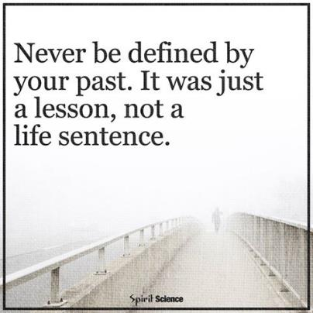
Dignity of Risk and Mistakes
Friends, family,
enough money,
job I like, home, faith, vacations, health, choice, freedom
Poverty, loneliness, segregation, restrictions, lack of choice, boredom
Notes:
-People need to be allowed to take risks and make mistakes – and not pay for it forever. We all make mistakes, have consequences, and move past it – but PWD often are labeled or restricted for life if they make even a simple mistake. “fire-starter” “sexual predator” “can’t use the internet”
-Person doesn’t learn to STAY SAFE if someone is always protecting them from everything! Learn how to stay safe by having life experiences – learning to say NO; learning who to trust or not;

Slide 35
Life Domains, Life Outcomes, and Life Possibilities

Slide 36






Achieving Outcomes for
Connected Life Domains
Daily Life and Employment
(school/education, employment, volunteering, routines, life skills)
Healthy Living
(medical, behavioral, nutrition, wellness, affordable care)
Community Living
(housing, living options, home adaptations and modifications, community access, transportation)
Safety and Security
(emergencies, well-being, legal rights & issues, guardianship options & alternatives )
Social and Spirituality
(friends, relationships, leisure activities, personal networks, faith community)
Advocacy and Engagement
(valued roles, making choices, setting goals, responsibility, leadership, peer support)
Notes:
Explain each domain. They are all interrelated and connected. The service system tends to want to focus only on health and safety.
Cocktail party conversations…
Think about the kinds of conversations we have at a cocktail party. We actually go through the Life Domains as part of our conversation.
Do you work? Where do you work?
Where do you live?
Where do you work out? Where do you run? Etc.
Quality of life areas!!

Slide 37

Looking at Life Possibilities
Innovative | Very new or undiscovered
Islands of Excellence | Exists in a lot of places but not everywhere
Traditional Options | Services that have existed for a long time
© 2016| UMKC Institute for Human Development, UCEDD | LIFECOURSETOOLS.COM
Notes:
TELEPHONE analogy
Talk about their handout (Life Possibilities)
We want people to be innovative - don’t just settle for what’s always been done or what is “available” – create something new!

Slide 38

Types of Support
The “3 Buckets”
Connecting & Networking
(Talking to someone that has been there)
Goods &
Services
(Day to Day, Medical, Financial Supports)
Discovery & Navigation
(Info and Training)
Notes:
The first bucket is Information (or Discovery and Navigation). Sometimes, we don’t need anything but information about a topic so we can make a decision or simply know what’s going on.
The second bucket is Connecting. We have learned that people and family members benefit from talking to others who have been in their shoes and can relate to what they might be going through at that time.
Finally, Goods and Services are those things that we connect with to make our daily lives possible. They can be as simple as your alarm clock or as complex as applying for formal services.
We always want to make sure we are filling all of our buckets, not just dropping everything into the goods and services bucket.
The 100% can have access to the 3 buckets - even if they never receive formal services. ALL PEOPLE (disability or not) and families need these types of support.
--YOU don’t have to know everything or provide it – but you can refer them to someone that does. Every state has a family to family organization, and many have parent to parent networks.
Families feel isolated and try to do everything on their own. Encourage them to share and expand what is in their buckets. As simple as meeting another parent to share some of the driving.
If you have a short example or story, add here. I sometimes share the first time I connected with another parent

Slide 39
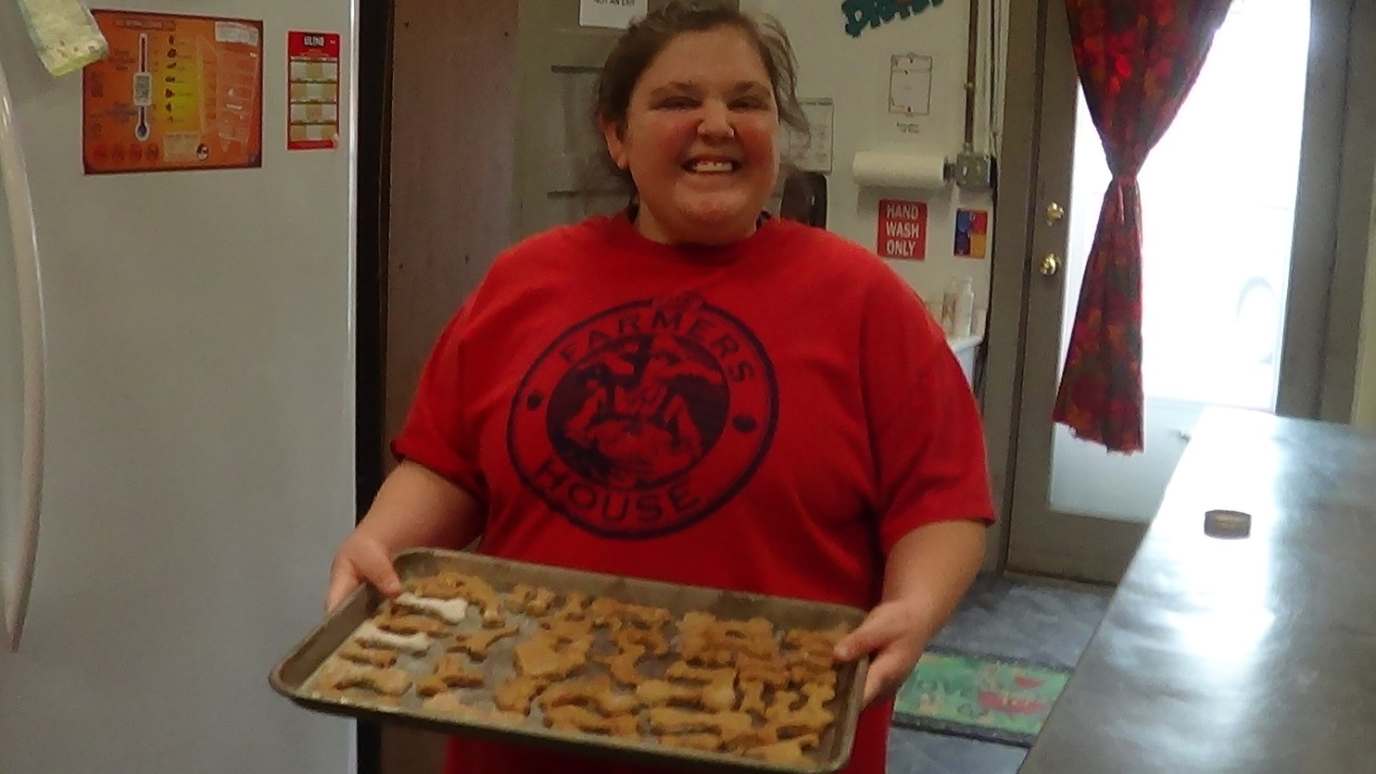
Integrated Star for Problem Solving & Exploring Options
Notes:
HOW do we get the supports needed for the GOOD LIFE???

Slide 40
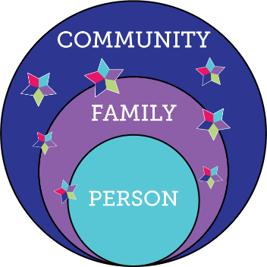

Charting the LifeCourse Integrated Supports STAR
100%
Notes:
Don’t put all your eggs in ONE basket. If Plan A fails and you don’t have plan B-You’re in trouble!
Star can be used lots of different ways
MAPPING
PROBLEM SOLVING
PLANNING LTSS
PLANNING ACTIVITIES
We ALL do this without even thinking about it – this just gives you an organizing framework to think about it

Slide 41
Charting the LifeCourse Integrated Supports STAR
100%
Notes:
Who are the people in our lives? Who could help out with one small thing – ie – a ride to work; hang out with your child while you go to the doctor; go with you to a movie

Slide 42
Charting the LifeCourse Integrated Supports STAR
100%
Notes:
We sometimes forget to look at our own strengths or skills or assets. What can we use, learn, etc to build capacity or support our needs? Jane’s example, her son may never drive, but I want him to have a car someday so others can use it to get him places – if the car is moving, Ben is in it!

Slide 43
Charting the LifeCourse Integrated Supports STAR
100%
Notes:
Who doesn’t use technology these days? Ask if there’s anyone in the room that doesn’t have a smart phone, Ipad, notebook or computer with them today. Technology can be high tech or low tech. There is so much available on the open market now, we no longer need to go to expensive speciality providers to get the tech we want.
The Nisonger Center has the Smart Home Discovery Place
My favorite (at least for now) are the ”Nest” cameras – you can get them fairly inexpensively and we installed one at our front door so when someone is there, the camera activates my cell phone and I can speak to them and they don’t know if I am at home or 2000 miles away – this gives me a lot of peace of mind when Ben is home alone.

Slide 44
Charting the LifeCourse Integrated Supports STAR
100%
Notes:
What are the places, groups and resources in the community that any community member might use or have access to?

Slide 45
Charting the LifeCourse Integrated Supports STAR
100%
Notes:
Even if someone gets paid services, they can make those services go further, as well as enhance quality of life, by tapping into the other parts of the star. People say it takes a village – in this case it takes a star (the Integrated Supports Star) to have a good life for all.
When you do think about eligibility supports, think beyond DD services. What else might someone be eligible for based on age, gender or income? Things like food stamps, HUD housing, senior citizen discounts, etc.

Slide 46
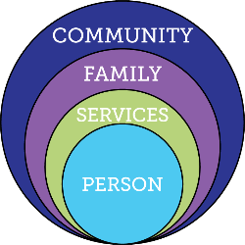

Focusing ONLY on Eligibility Supports
Friends, family, enough money,
job I like, home, faith, vacations, health, choice, freedom
Eligibility Supports
Poverty, loneliness, segregation, restrictions, lack of choice, boredom, institutions
Notes:
Don’t put all your eggs in one basket – or rely on just one part of the star. For example, if you are only counting on paid services to get you to your good life, what if something happens where you no longer are able to receive those services? What would that do to your trajectory?

Slide 47
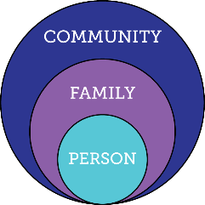

Relying ONLY on Family & Friends
Friends, family, enough money,
job I like, home, faith, vacations, health, choice, freedom
Relationships
Poverty, loneliness, segregation, restrictions, lack of choice, boredom, institutions
Notes:
Same thinking if all the reliance is on the family to support the trajectory to the good life vision. What if the family is no longer in the picture or no longer able to provide support?

Slide 48
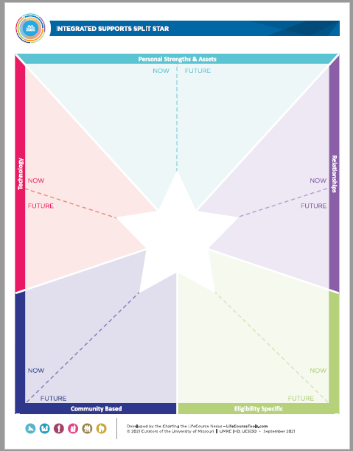
How did a Parent Mentor use this tool?
A parent mentor I spoke to uses the split star to identify where a child is now and to help prepare for needs and opportunities in the future.

Slide 49
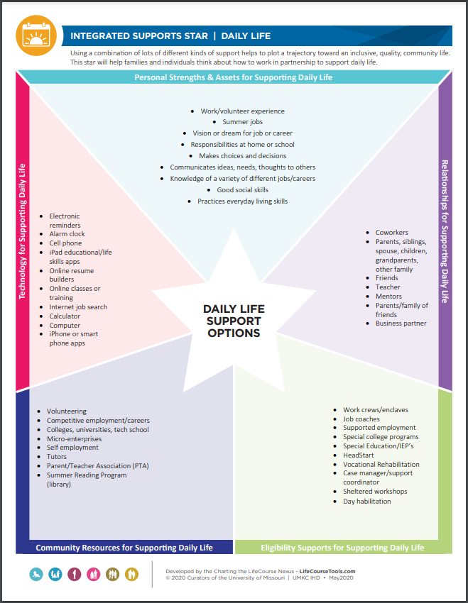

Slide 50
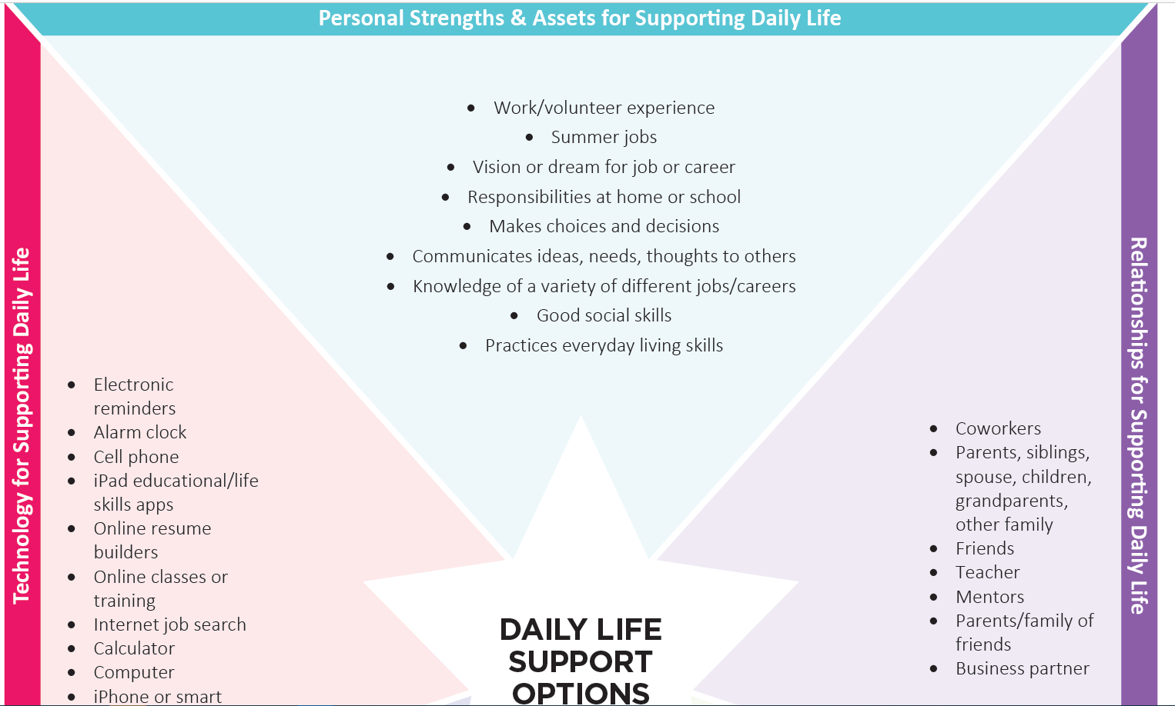

Slide 51
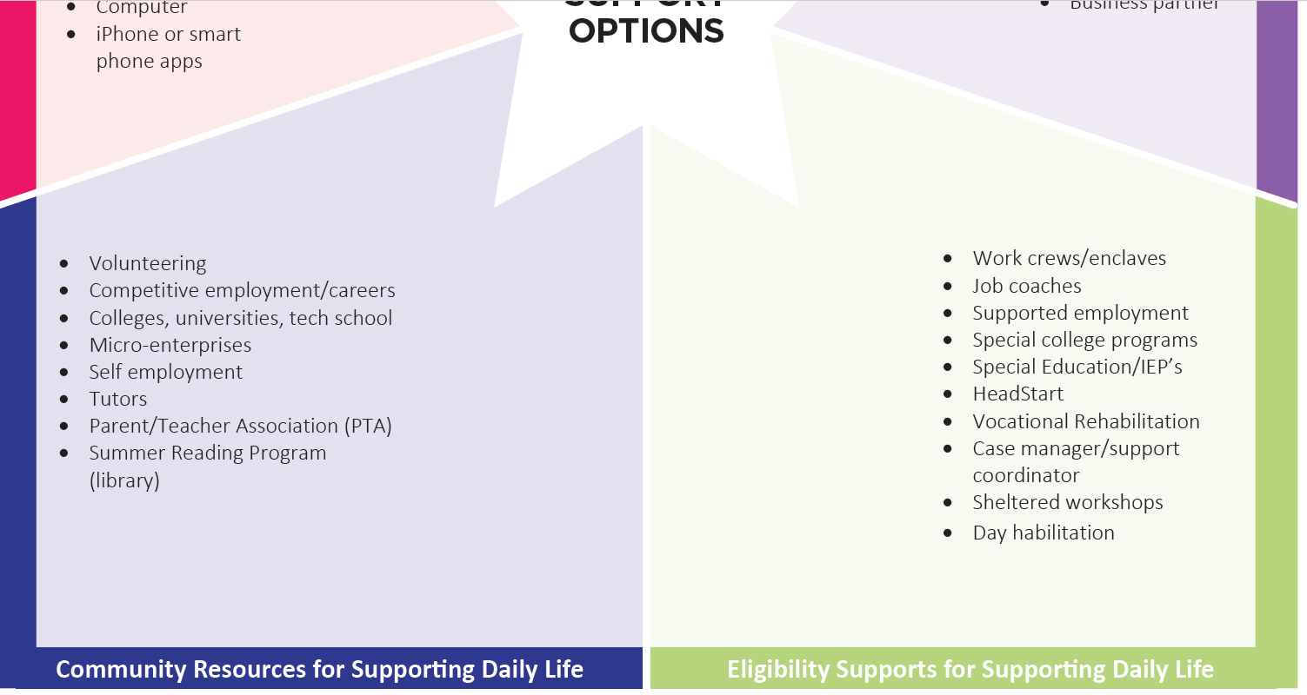

Slide 52

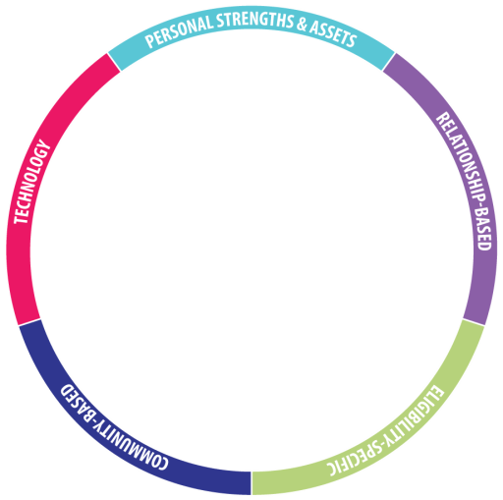
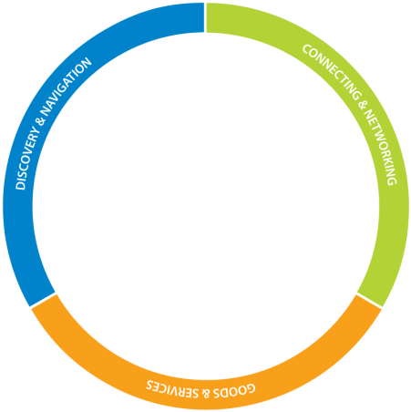
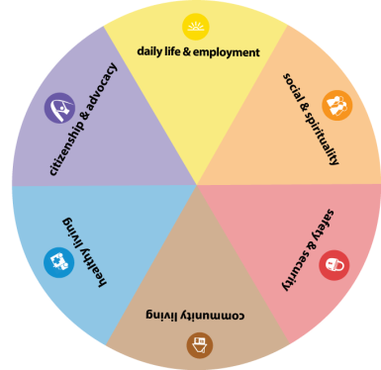








Notes:
So to recap:
[One click at a time]
You have the person
In the context of family and community
The life domains – all interrelated
The 3 buckets of support that we all need
The integrated supports star
The trajectory toward a vision for a good life
And the life stages, which build upon one another

Slide 53
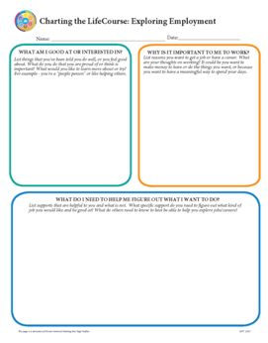







lifecoursetools.com
Planning for Life Outcomes and/or
Service Planning
Self-Advocate
Tools & Resources
Family Perspective
Tools
Formal Planning
Tools and Forms
800-444-0821
Notes:
Visit lifecoursetools.com to learn more or download any of the tools.

Slide 54





RESOURCES:
www.FRNOhio.org
  https://ddc.ohio.gov/
www.education.ohio.gov
www.lifecoursetools.com
  www.dodd.org

Slide 55
Please fill out the Post-Survey and Evaluation - Thank You!

Slide 56

Please scan and complete the evaluation
FRNO is grant funded and these evaluations are essential to our grant’s success.

