Slide 1
Positioning Families as Experts:
School Reentry and Postvention Following Hospitalization or Suicide
Dr. Jamie M. Hall

Slide 2
In-Person Objectives
Participants will analyze de-identified case studies with peers and discuss strategies for empowering families during school reentry following a mental health crisis
Participants will be provided with resources for creating personal and professional self-care practices that are sustainable and promote longevity within their careers

Slide 3
Session Structure
Checking in
Questions from pre-recorded presentation
Break out into small groups of 5-6 and work through a case study using the provided prompts
Debrief as a large group on the case studies

Slide 5
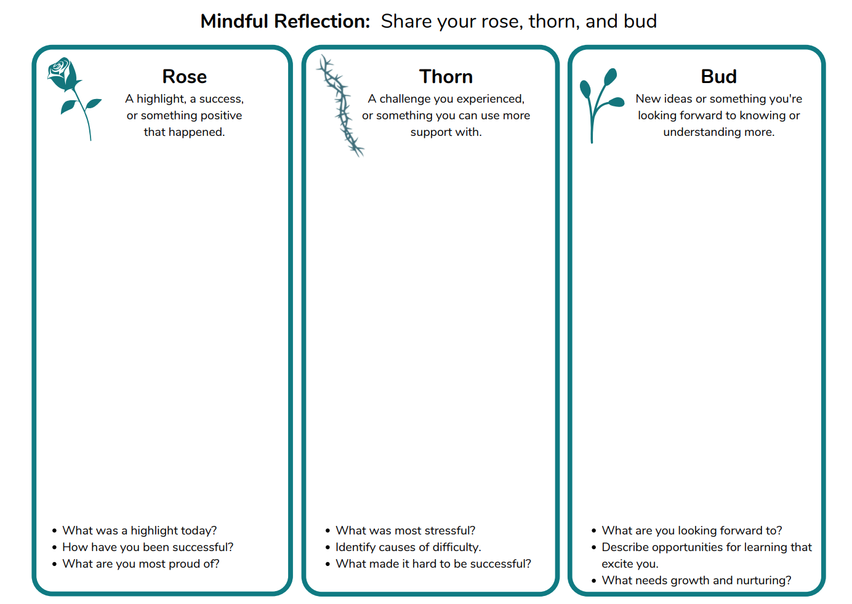

Slide 6
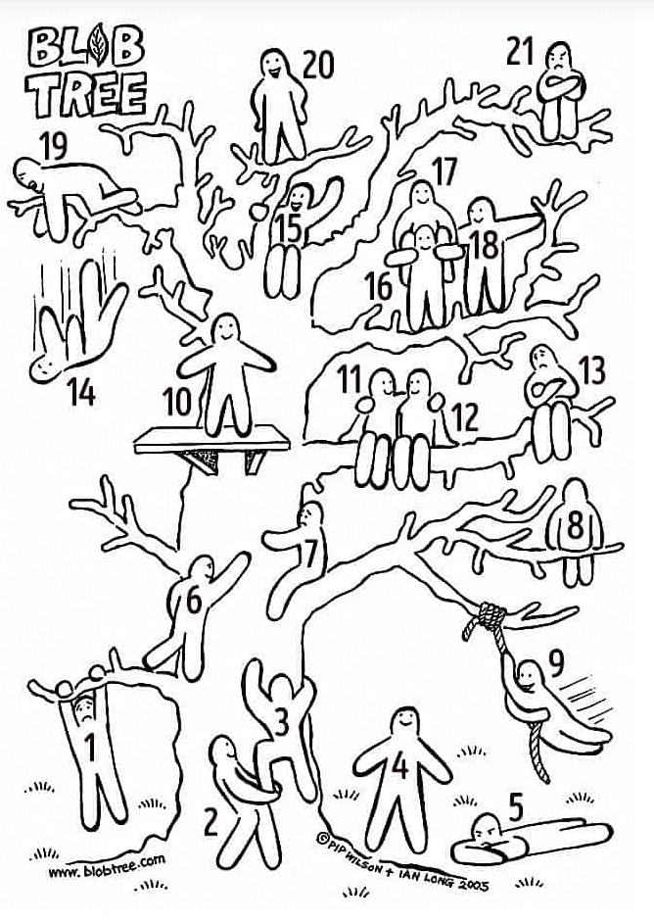

Slide 7
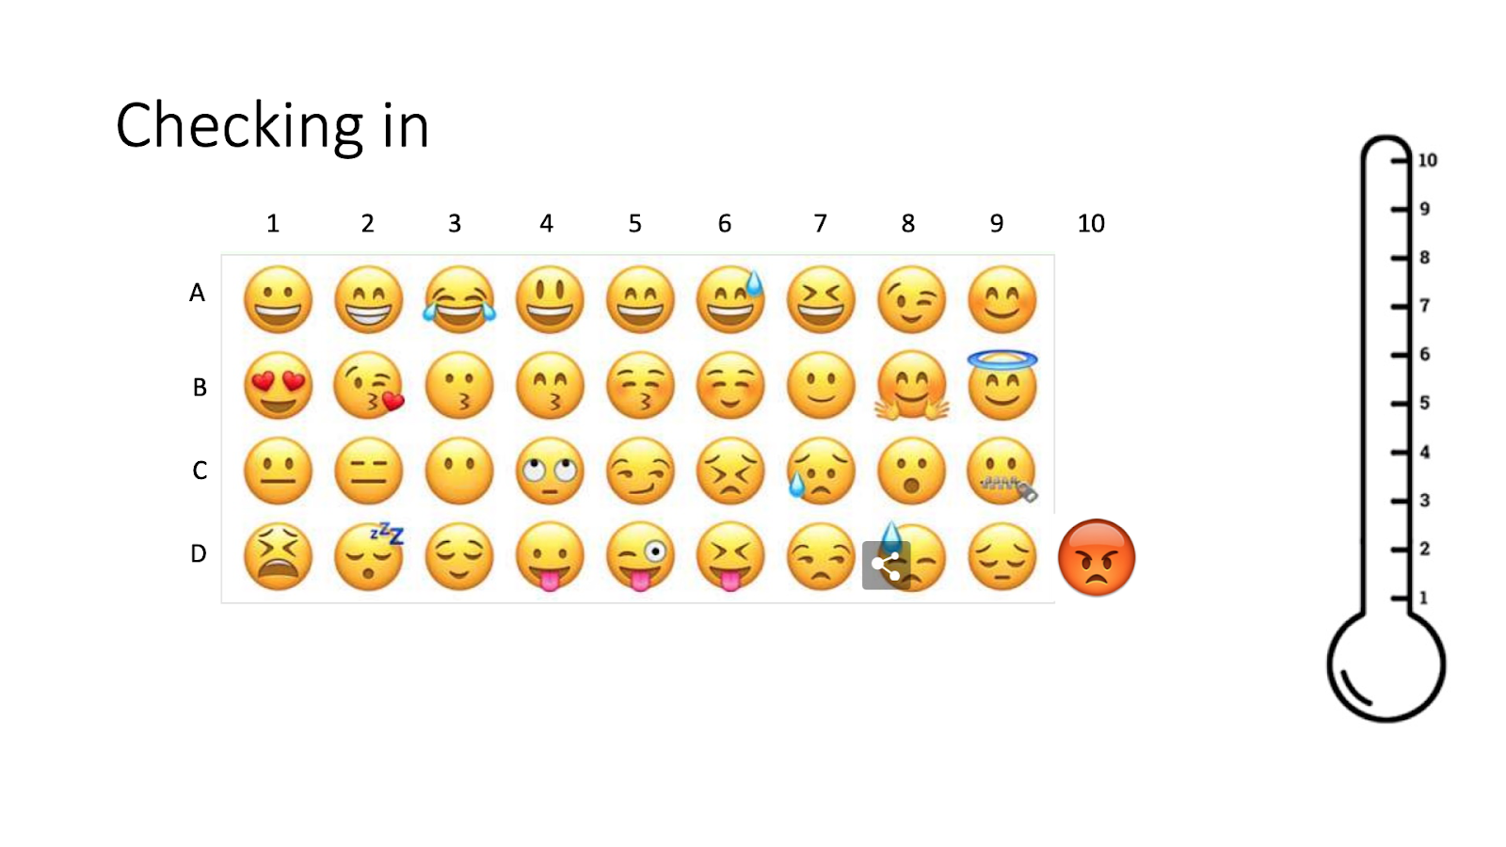

Slide 8
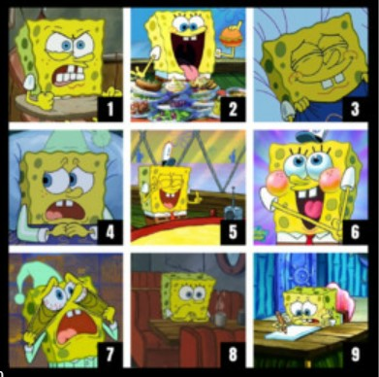

Slide 9
What questions do you have from the pre-recorded lecture?

Slide 10
Case Study Analysis (Small Groups)

Slide 11
Debriefing (Large Group)

Slide 12
Resources
Crisis Text Line: Text HOME to 741741
About: 24/7 support for people in crisis by a trained volunteer
National Suicide Prevention Lifeline (NSPL): 1-800-273-TALK (8255); https://suicidepreventionlifeline.org/
About: 24/7 support for people in distress, prevention and crisis resources for you or your loved ones
The Trevor Project (LGBTQIA+): www.thetrevorproject.org
About: 24/7 lifeline (866-488-7386); TrevorText – (text “Trevor” to 1-202-304-1200) and TrevorChat (online through the website) are available limited hours Monday - Friday

Slide 13
Thank you!
drhall5182@gmail.com

